Slide 1


Nominees: Reporting Professor’s Benefits
Stephanie Nonluecha
U.S. Office of Government Ethics

Slide 2
E.O. 12731 §102
Outside Earned Income Ban
Sec. 102. Limitations on Outside Earned Income. Provides in part:
No full-time PAS may receive any earned income for any outside employment or activity performed during that Presidential appointment.

Slide 3
18 U.S.C. 209
Supplementation of Salary
18 U.S.C. § 209(a) prohibits:
An officer of the executive branch or an independent agency of the United States Government from
receiving salary or any contribution to or supplementation of salary from
any source other than the United States
as compensation for services as an employee of the United States.

Slide 4
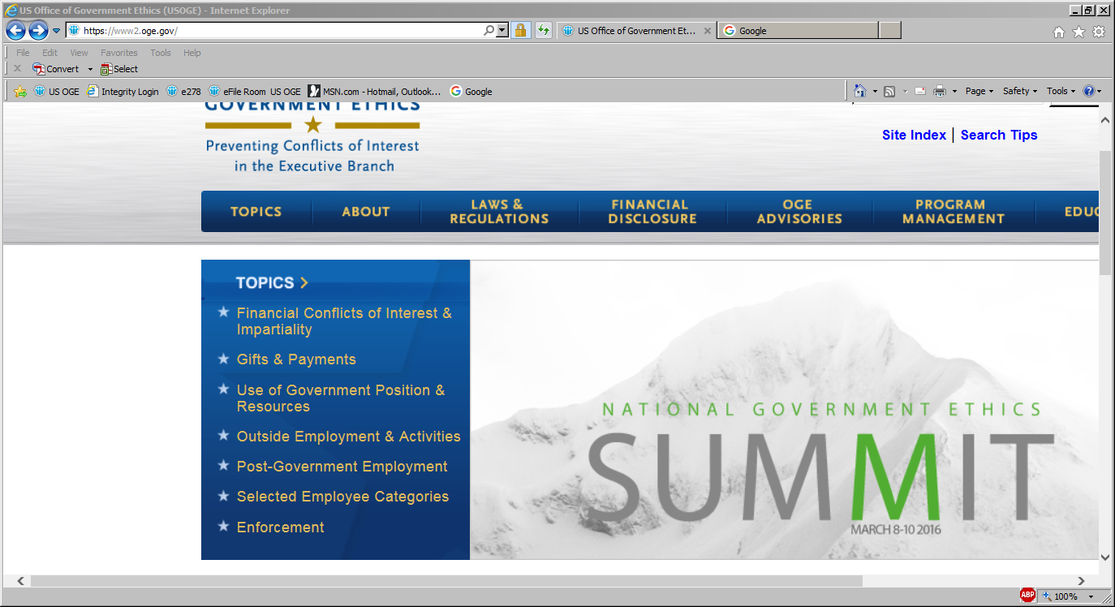
Resource: OGE Website www.oge.gov

Slide 5
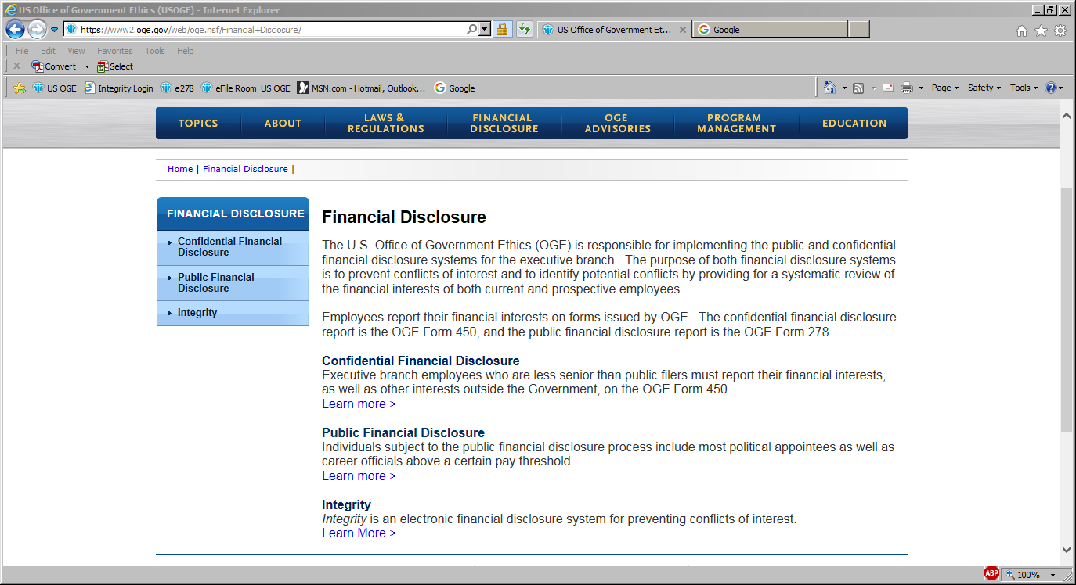

Slide 6
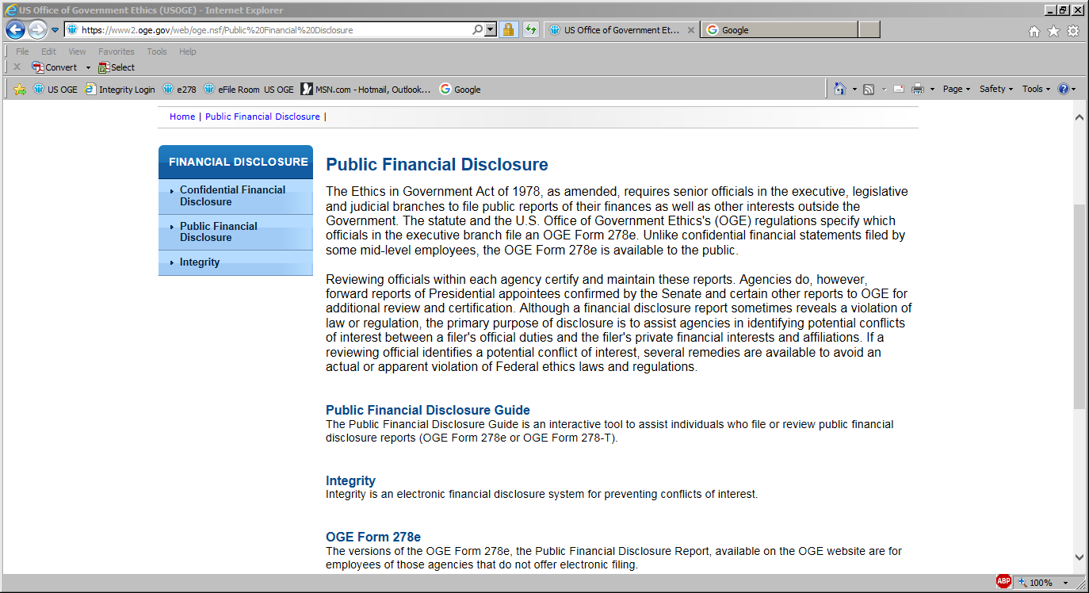

Slide 7
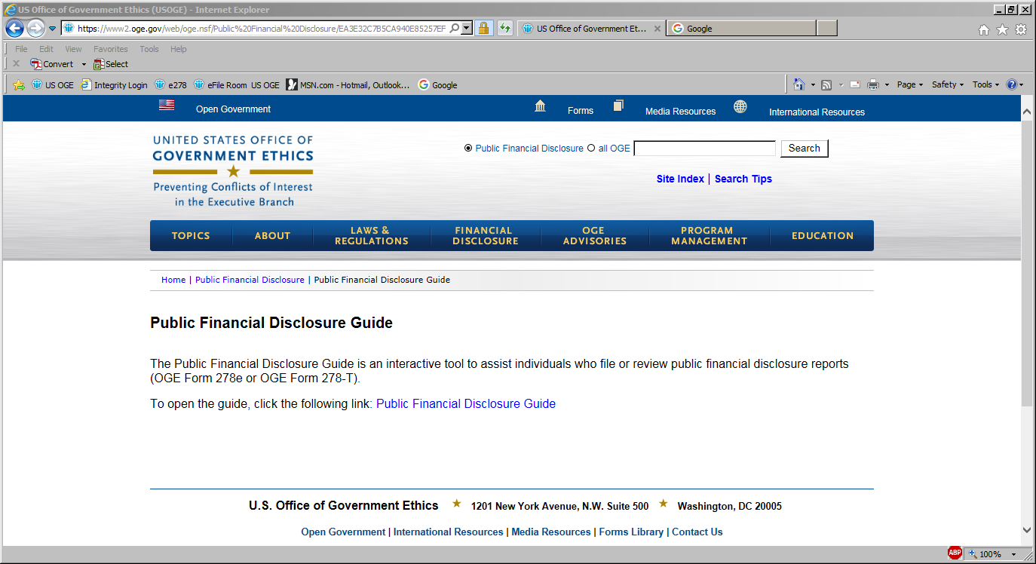
Resource: Public Financial Disclosure Guide

Slide 8
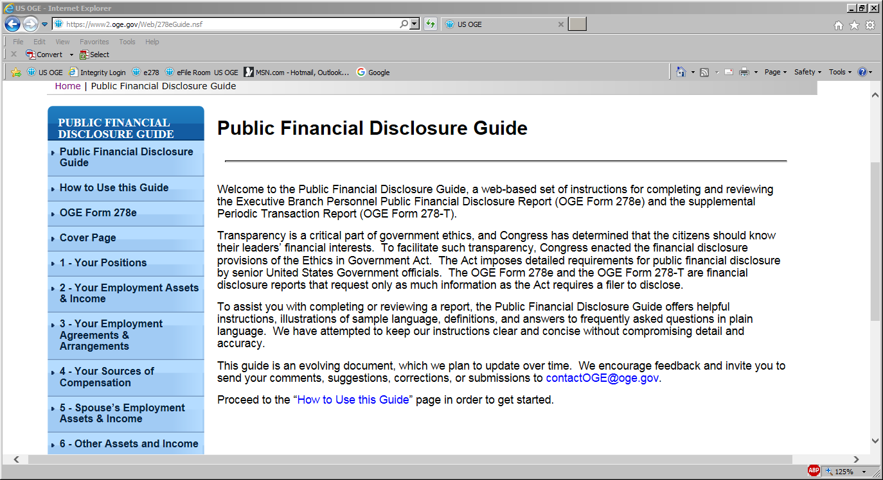
Public Financial Disclosure Guide

Slide 9
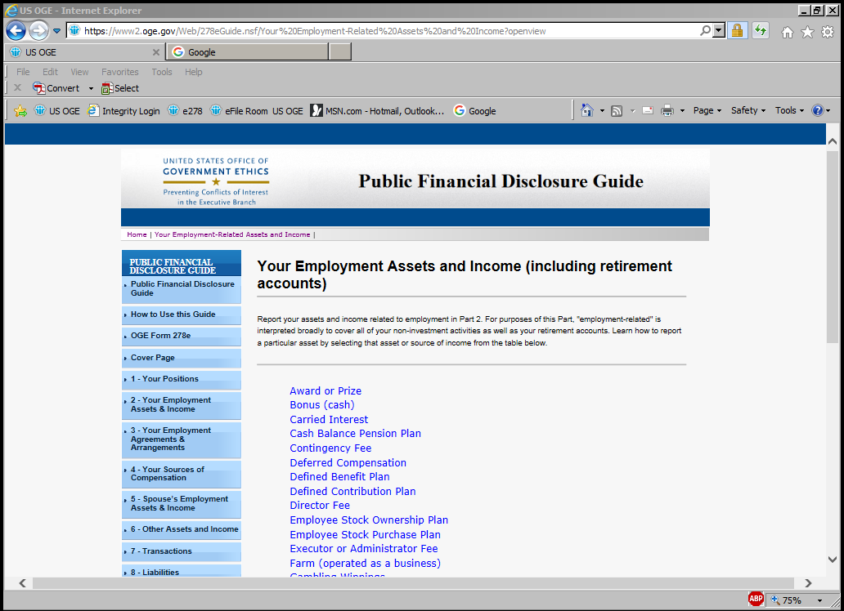
Part 2 – Filer’s Employment Assets and Income

Slide 10
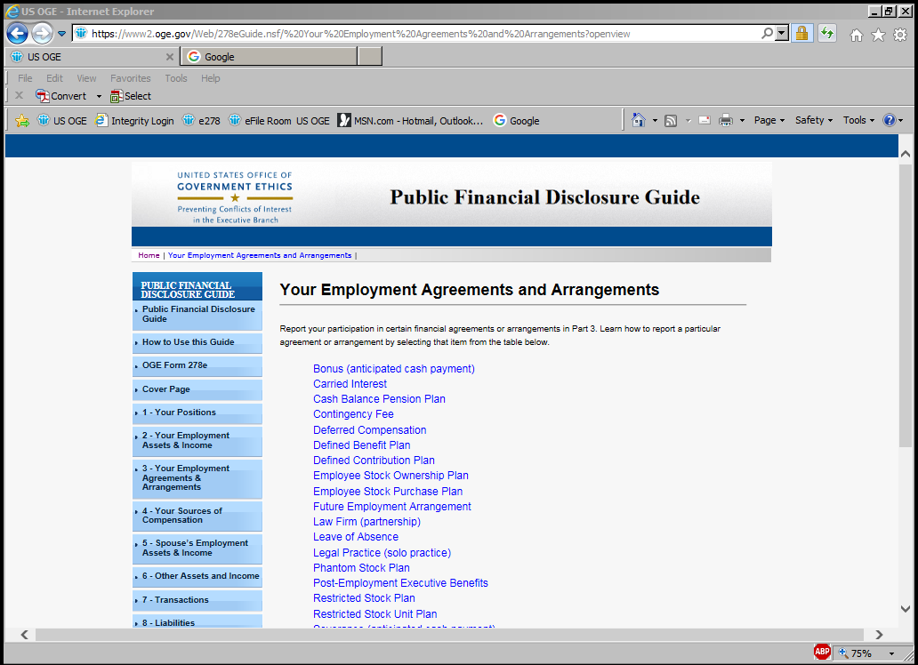
Part 3 – Filer’s Employment Agreements and Arrangements

Slide 11
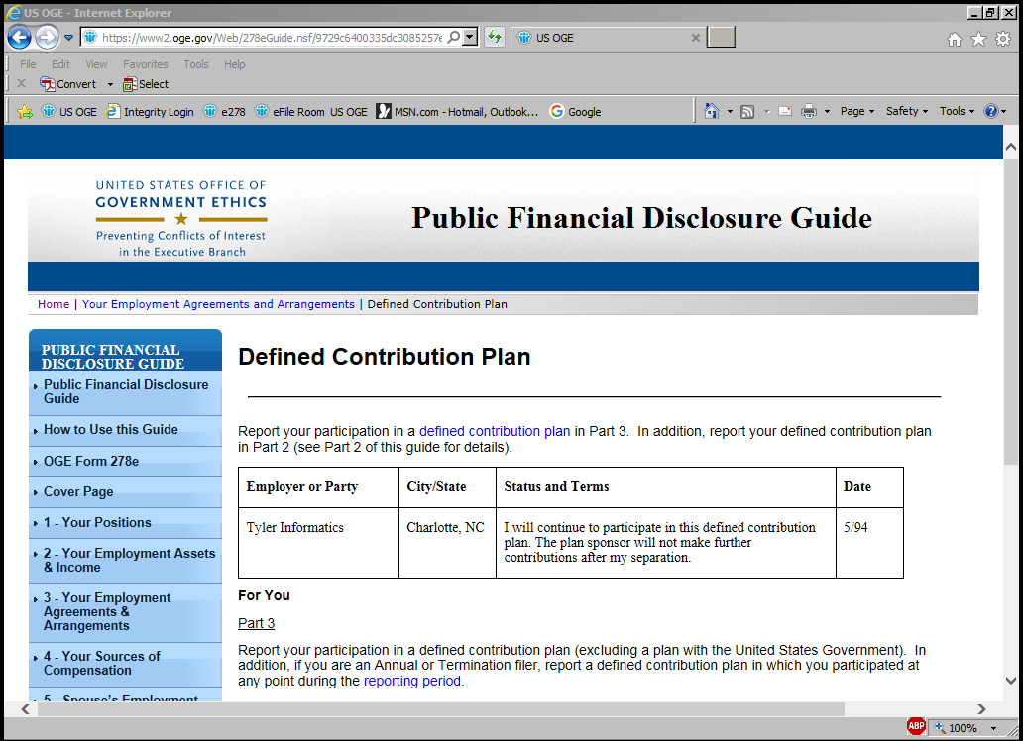
Part 3: Filer’s Employment Agreements and Arrangements

Slide 12


Slide 13

Retirement plans
Health/Life Insurance
Reduced rate mortgage
Mortgage subsidies
Housing allowance
Tuition assistance (college tuition, subsidized day care, nursery school, other)
Student loan forgiveness
Use of office space, email account, research assistants, research facilities, library system
Access to university gym or healthcare facilities

Slide 14

Defined Benefit Plan: 278e Reporting
Part 2: Filer’s Employment Assets and Income
Description | EIF | Value | Income Type | Income Amount
East State University ,defined benefit plan (value not readily ascertainable): eligible for $3,000/mo. at age 65 | N/A |  |  | None (or less than $201)
Part 3: Filer’s Employment Agreements and Arrangements
Employer or Party | City/State | Status and Terms | Date
East State University | Fresno, CA | I will continue to participate in this defined benefit plan. | 8/92

Slide 15
Defined Contribution Plan:
278e Reporting
Part 2: Filer’s Employment Assets and Income
Description | EIF | Value | Income Type | Income Amount
East State University 403(b) : | N
- ABC Diversified Bond Fund | Y | $50,001 - $100,000 |  | $1,001 - $2,500
Part 3: Filer’s Employment Agreements and Arrangements
Employer or Party | City/State | Status and Terms | Date
East State University | Fresno, CA | I will continue to participate in the East State 403(b) plan. The university will not make contributions during my leave. | 8/92

Slide 16


Health/Life Insurance Benefits:
278e Reporting
Part 3: Filer’s Employment Agreements and Arrangements
Employer or Party | City/State | Status and Terms | Date
East State University | Fresno, CA | During my leave of absence, I will continue in East State University’s Health Care Benefits program and Life Insurance program, but I will pay for all costs associated with the Health Care and Life Insurance programs. | 2/16

Slide 17



Reduced rate mortgage
Mortgage subsidies
Housing allowance
Tuition assistance (college tuition, subsidized day care, nursery school, other)
Student loan forgiveness
Reduced rate mortgage
Mortgage subsidies
Housing allowance
Tuition assistance (college tuition, subsidized day care, nursery school, other)
Student loan forgiveness

Slide 18
Other Benefits 278e Reporting
Part 3: Filer’s Employment Agreements and Arrangements
Employer or Party | City/State | Status and Terms | Date
East State University | Fresno, CA | Pursuant to University policy, I am entitled to a reduced rate mortgage. | 8/92
East State University | Fresno, CA | Pursuant to University policy for tenured faculty on leave of absence, I am entitled to access to the University’s gym and clinical/medical facilities. | 4/09
East State University | Fresno, CA | Pursuant to University policy for tenured faculty on leave of absence, I am entitled to use of office space, use of research assistants, and use of e-mail account. However, I will forfeit these benefits for the duration of my appointment. | 4/09

Slide 19



Other Benefits
Access to university gym or healthcare facilities

Slide 20

Use of office space, email account, research assistants, research facilities

Slide 21
Ethics Agreement: 2.4.3 – limited 208 recusal related to other continuing employee benefits
Sample Language:
Upon confirmation, I will take an unpaid leave of absence from my position as Associate Professor at East State University. Pursuant to East State University policy for tenured faculty on leave of absence, I am entitled to receive health insurance, life insurance, a reduced rate mortgage, access to the University’s clinical/medical facility, and use of the gym facility on campus. In addition, pursuant to University policy for tenured faculty on leave of absence, I am entitled to use of office space, use of research assistants, and use of the University e-mail account. For the duration of my appointment to the position of Under Secretary, I will not use the shared office, shared professional assistant, and the University e-mail account. I will not participate personally and substantially in any particular matter that to my knowledge has a direct and predictable effect on the ability or willingness of East State University to provide these benefits, unless I first obtain a written waiver, pursuant to 18 U.S.C. § 208(b)(1).

Slide 22
Dealing with professors
Tips
Do own research
(Internet search, University website, etc.)
Ask a lot of questions
Be hands-on
Provide detailed information, instructions, illustrations, etc.
Counsel, counsel , counsel

Slide 23

Stephanie Nonluecha
Program Analyst (Finance)
Presidential Nominations Branch
U.S. Office of Government Ethics
(202) 482-9243
snonlue@oge.gov

